Slide 1

Powering Up The Positive
Mindset Matters: Session 2

Slide 2
Part 1: Toxic positivity
Part 2: The brain
Part 3: Dialling down negativity
Part 4: Dialling up positivity
Today

Slide 3
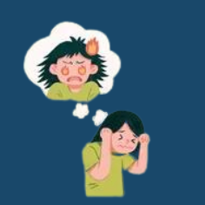
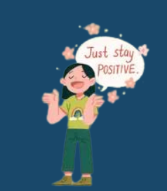
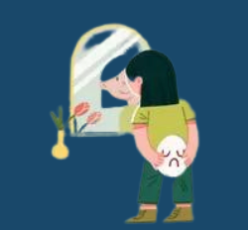
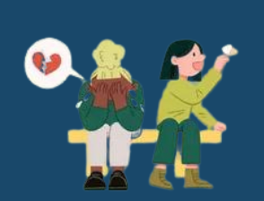
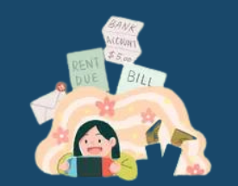
Source: Very Well : Laura Porter
Signs of
Toxic Positivity
Experiencing guilt for being
sad or angry
Reciting positive quotes about
hard situations
Hiding painful emotions
Dismissing others' difficult feelings
Ignoring your problems

Slide 4

12000-50000 thoughts a day
80% are likely to be negative
95% the same thoughts on repeat
Our brains are wired for negativity

Slide 5

Withdrawals and deposits are not created equally
Need ratio of between 1:3 & 1:5

Slide 6
Overwhelm
Worry
Loss
Fear
Anger
Resentment
6 Energy Zappers
What are the things that can spark these (or any other) negative emotion for you?
What impact does this have?

Slide 7

Journalling
Talk with a friend
Get the thoughts out of your head
Give voice to your emotions in a way that is productive

Slide 8

5 MINUTE TOOL: THINK, WRITE, FEEL
At the end of each day write down three good things that happened during the day. Write a sentence or two to really describe the great feelings - get specific.
PRO TIP
Keep a pad and pen by the side of your bed. Build this into your night time routine. Don’t just think it and write it. Try to really feel it - truly savour the good.

Slide 9
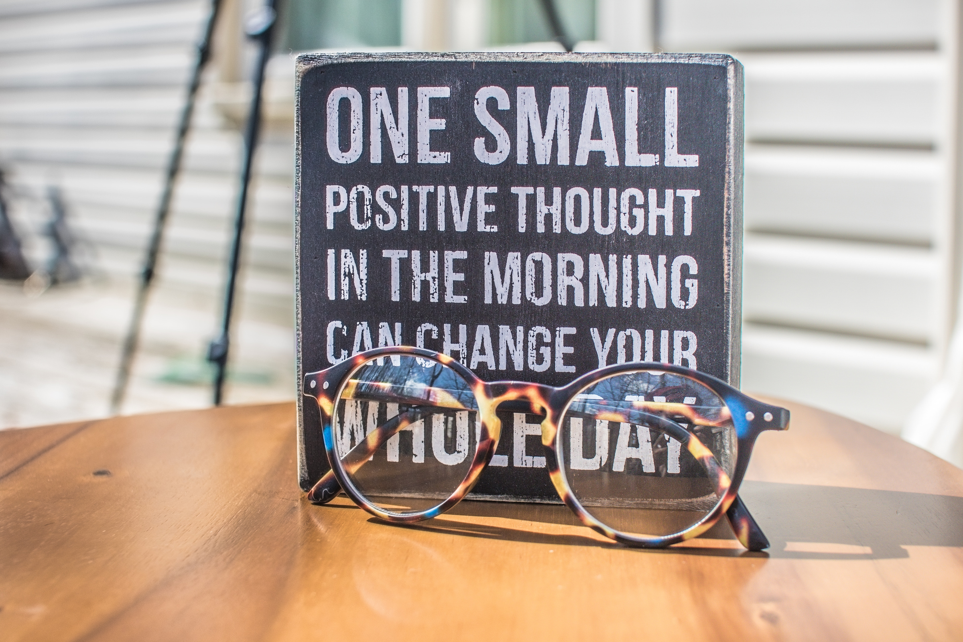
2 MINUTE TOOL: THE MORNING POWER UP
Each morning, ask yourself: How do I want to feel today?
Use positive, powerful words and vivid descriptions. In doing this you’re doing what’s called ‘positive priming’ and you’re priming your brain to look out for things that help you to feel this way throughout your day.
PRO TIP
You can return to this exercise at any point in the day if you find yourself saying things like - I’m so stressed, I feel terrible, I’m exhausted.
Switch to 'I feel...'
Then ask: Is this how I want to feel? How do I want to feel instead?
Think of the next best thought.

Slide 10

5 MINUTE TOOL: JOLTS OF JOY
Write down 5 things that really make you smile and feel happy. It could be a favourite song, a funny dog video on YouTube, a cartoon, a photo of someone you love or who makes you laugh, a joke, an image of a holiday, place, happy memory, a game that relaxes you.
Create an electronic folder and keep it accessible on your phone or laptop so when you feel negativity closing in, reach for a JOLT and notice how your brain responds.
PRO TIP
At the end of every day as you brush your teeth and get ready for bed, make a note (mental or written) about what’s creating genuine positive emotions for you at the moment and how you might build on this tomorrow and/or add it to your JOLTS.

Slide 11
What are your 'go-tos' for powering up the positive?
Share with each other and choose two to share with the group when you return.

Slide 12
Part 1: Toxic positivity
Part 2: The brain
Part 3: Dialling down negativity
Part 4: Dialling up positivity
Today
What are your biggest takeaways from each of these 4 sections?
What will you put into action after today's session?

